Slide 1
MEDICAL IMAGE SECURITY & ANOMALY DETECTION
By:
S.R. Vidhyambika,
2nd year MTech DS,
Deptartment of IT,

Slide 2
PROBLEM STATEMENT
“Inadequate encryption and access control for medical images jeopardize patient data security and regulatory compliance, especially as digital imaging grows and cyber threats evolve. Existing security measures often fail to protect against modern, complex threats and lack effective anomaly detection, leaving medical images vulnerable to tampering and unauthorized access. This could compromise diagnostic accuracy, violate healthcare regulations, and undermine patient privacy and trust.”
PURPOSE: The motto of this project is to design a more comprehensive security framework that integrates advanced hybrid encryption techniques, secure access control, role-based authentication, and real-time anomaly detection to protect medical images and ensure compliance with privacy regulations.
🔒

Slide 3
ABSTRACT
With the growing reliance on digital healthcare, safeguarding medical images is crucial to protect patient privacy, ensure trust, and prevent data tampering.
This project enhances medical image security using hybrid encryption and hashing algorithms, including RSA+AES+SHA-256, ECC+AES+SHA-256, AES+SHA-256, DNA Cryptography+AES, Blowfish+SHA-256, Chaotic Maps+AES, and DES+AES+MD5.
Medical images in formats like DICOM and JPEG are encrypted, ensuring compliance with HIPAA, GDPR, and India’s Digital Personal Data Protection Act.
These algorithms are evaluated using metrics like PSNR, SSIM, MSE, entropy, edge preservation, and encryption time, achieving SSIM of 1.0, PSNR as infinity, MSE as 0, entropy > 7, and encryption times under 1 ms (per image).
Additionally, deep learning-based anomaly detection including Autoencoders with CNN model and Generator Adversarial Networks with CNN model analyzes large datasets to identify unauthorized alterations and transmission errors, enabling real-time detection of compromised images.
This approach ensures robust security, preserves image quality, minimizes encryption time, and protects against attacks like brute-force, cryptanalysis, and data breaches.

Slide 4
INTRODUCTION
Medical images, such as X-rays, MRIs, CT scans, etc., are essential for diagnosing and monitoring diseases but contain sensitive patient information, raising concerns about privacy, security, and unauthorized access when sharing across multiple devices.
The growth of digital healthcare and telemedicine has made 2D and 3D medical images increasingly vulnerable to cyber threats.
These threats include ransomware, Distributed Denial-of-Service (DDoS) attacks, data breaches, brute force, and Man-in-the-Middle (MITM) attacks, potentially leading to misdiagnosis, improper care, and privacy issues.
This project addresses medical image security and anomaly detection.
Phase 1 focuses on securing 2D images using hybrid encryption, Multi-Factor Authentication (MFA), and Role-Based Access Controls (RBAC), while Phase 2 uses AI to analyze datasets for detecting unauthorized alterations and transmission errors, enabling real-time identification of compromised images.
The project ensures compliance with strict regulatory standards, including the Health Insurance Portability and Accountability Act (HIPAA) in the United States, the Digital Personal Data Protection Act in India, and the General Data Protection Regulation (GDPR) in the European Union.
By combining multiple encryption algorithms, it aims to provide multi-layered encryption that resists attacks and unauthorized access. MFA and RBAC ensure only authorized users have access, with roles determining accessibility.

Slide 5
OBJECTIVES
This project aims to develop a robust framework ensuring the integrity, confidentiality, authenticity, and reliability of medical imaging data during encryption and decryption, while detecting anomalies in data access and transmission.
Key objectives include:
Confidentiality: Protects patient data from unauthorized access, ensuring privacy and regulatory compliance.
Integrity: Ensures images remain accurate and unaltered, using cryptography and secure protocols for encryption.
Authenticity: Verifies images are genuine through digital signatures and authentication mechanisms.
Reliability: Ensures image availability for clinical decisions with robust storage solutions and backup systems.
Anomaly Detection: Continuously monitors and addresses irregularities, maintaining image security throughout it’s lifecycle.

Slide 6
SCOPE
Overview:
Develop a solution for encryption of medical images, authorized access control and detection of irregularities or anomalies in medical scans.
Deliverables:
End-to-End Encryption (E2EE) using Advanced Encryption Techniques
Accompanied by Deep learning based anomaly detection
Encryption validation
Access control testing
Documentation
Components:
Medical images:
2D:
1. X-ray
2. Mammography
3. Optical Coherence Tomography (OCT)
4. Ultra sound
5. Fluoroscopy
3D: (Not Used/Included)
1. Computed Tomography (CT) scan
2. Magnetic Resonance Imaging (MRI)
3. Positron Emission Tomography (PET)
Hybrid Encryption algorithms for 2D image security and security based anomaly detection
Deep learning algorithms for anomaly detection

Slide 7
LITERATURE SURVEY
S.No | PAPER TITLE | AUTHOR | DESCRIPTION | PUBLISHER & YEAR
1. | Blind and Robust Watermarking Scheme in Hybrid Domain for Copyright Protection of Medical Images | Ali Alzahrani & Nisar Ahmed Memon | Singular Value Decomposition(SVD), Discrete Wavelet Transform (DWT) and Discrete Cosine Transform (DCT) algorithms were used to watermark images based on spatial and frequency domains. | IEEE - 2021
2. | Chaos Based Secure Medical Image Transmission Model for IoT- Powered Healthcare Systems | Sujarani Rajendran, Manivannan Doraipandian | Used Message-Digest (MD5) algorithm and Lorenz map to generate chaotic series for each medical image. | IOP Science - 2021
3. | DeepKeyGen: A Deep Learning-Based Stream Cipher Generator for Medical Image Encryption and Decryption | Yi Ding, et al. | Uses DeepKeyGen which comprises A generator to generate private key from initial image, a discriminator to distinguish between the private key generated by the generator and the real data from the transformation domain | IEEE - 2021
4. | Lossless image compression-encryption algorithm based on BP neural network and chaotic system | Feifei Yang et al. | Used BP Neural network, Zigzag confusion and Chaotic Pseudo random sequences to compress & encrypt images | Springer - 2020

Slide 8
LITERATURE SURVEY(Contd)
S. No | PAPER TITLE | AUTHORS | DESCRIPTION | PUBLISHER & YEAR
5. | A Novel Plaintext-Related Image Encryption Scheme Based on Chaotic System and Pixel Permutation | Ying Niu, Xuncai Zhang | Uses SHA(384) & Piecewise Linear Color Mapping(PWLCM) to scramble images, chaotic system to generate chaotic sequences for each image and diffuses both to obtain cipher image. | IEEE - 2020
6. | Efficient anomaly detection from medical signals & images with convolutional neural networks for Internet of Medical Things(IoMT) systems | Ali A Khalil et al. | Uses CNN with Convolution with ReLU activation, pooling , dense, softmax layers to detect anomalies. Highest accuracy was observed at 100 epochs | Wiley - 2021
7. | Generative Adversarial Networks for Anomaly Detection in Biomedical Imaging: A Study on Seven Medical Image Datasets | Marzieh Esmaeili et al. | Uses GANs in which generators and discriminators are trained simultaneously to generate fake images and validate it with original image. | IEEE - 2023
8. | Hyperspectral Anomaly Detection With Otsu-Based Isolation Forest | Yuxiang Zhang, et al. | Uses isolation forest by assembling multiple binary trees. To construct more discriminative binary tree, Otsu-based splitting criterion is applied to split subsamples into anomalies and backgrounds. | IEEE - 2021

Slide 9
LITERATURE SURVEY(Contd)
S. No | PAPER TITLE | AUTHORS | DESCRIPTION | PUBLISHER & YEAR
9. | AnoViT: Unsupervised Anomaly Detection and Localization With Vision Transformer-Based Encoder-Decoder | Yunseung Lee; Pilsung Kang | Uses AnoViT comprises encoder using ViT (Multi-head self-attention), a decoder containing a convolutional layer to extract representation that contains normal information in detail, patch embeddings, including relationship between the image patches to construct a three-dimensional feature map and sent to the decoder to preserve the spatial information well. | IEEE - 2022
10. | Anomaly Detection in Medical Imaging with Deep Perceptual Autoencoders | Nina Shvetsova, et al. | Uses autoencoder to understand representation of normal data & pretrained feature with hyper parameter tuning extractor to detect anomalies by calculating anomaly score | IEEE - 2021

Slide 10
EXISTING SYSTEM
Numerous studies on multimedia security focused on safeguarding medical images using techniques like watermarking, steganography, and limited encryption algorithms.
Common approaches included DES, Arnold scrambling, pixel permutation, Self-Adaptive Grey Wolf Optimization, LSB steganography, and transformations like SVD, DWT, DCT, chaotic maps, series, and the Lorenz map.
Steganographic algorithms uses cover images, with methods like LSB, to conceal sensitive medical data, while encryption algorithms, though less frequently researched, typically employed fixed or restricted key sizes for securing information.
Watermarking techniques were applied in spatial, frequency, or hybrid domains, with some studies addressing image distortion by segmenting the image into regions of interest (ROI) and non-interest, embedding watermarks in non-interest regions to preserve image quality.
These methodologies collectively aimed to protect medical images against various threats, including cryptanalysis, JPEG compression, cropping, filtering, brute-force attacks and chosen-plaintext attacks.
Drawbacks:
1. Watermarked images are prone to cropping, rotation, and compression attacks.
2. Limited datasets used in many studies can cause overfitting.
3. Encoding methods may visibly alter images, risking misdiagnosis in critical cases like cancer.
4. Techniques often yield low PSNR, reducing imperceptibility.
5. Poor watermarking distorts images, especially in 3D, affecting spatial consistency.
6. Encryption algorithms like DES are vulnerable to brute-force and cryptanalysis attacks.

Slide 11
METHODOLOGY (Achieved in Phase-1)
Collecting and pre-processing the medical images.
Storing medical images in Digital Imaging and Communications in Medicine (DICOM) format and Joint Photographic Experts Group (JPEG) format.
Encrypting medical images using encryption and hashing algorithms such as:
RSA+AES+SHA-256
ECC+AES+SHA-256
AES+SHA-256
Chaotic Maps + AES
DNA Cryptography + AES
Blowfish+SHA-256
DES+AES+MD5
Implementing all these multi-layer encryption algorithms as a final solution.
Evaluating the algorithms using evaluation metrics such as: Peak Signal-to-Noise Ratio (PSNR), Structural Similarity Index Measure (SSIM), Mean Squared Error (MSE), Edge preservation, Entropy and Encryption time to detect anomalies (data corruption, image quality distortion, tampering).
This provides a tamper-proof security for sensitive, highly-detailed medical images.
Integrate and test the entire system/solution to ensure seamless functionality, then optimize based on performance and document the methodology and findings for further refinement.
Utilizing any of proposed algorithms in the final solution based on the use case for secure transmission of data.

Slide 12
METHODOLOGY (Achieved in Phase-2)
Collecting and pre-processing the Pneumonia MNIST images and chest X ray dataset from kaggle.
Labelling images into 4 types of anomalies: 1. Scratches, 2. Blurred noise, 3. Contrast, 4. Brightness and 5. Normal.
Training the model to detect anomalies and classify their type using:
Autoencoder+CNN:
-> Autoencoder + CNN approach uses Autoencoders for unsupervised learning for anomaly detection and CNN for supervised classification for anomaly categorization.
-> This combination of autoencoder-based anomaly detection and CNN-based classification enables precise identification of different types of image distortions.
2. GAN + CNN:
-> GAN + CNN approach uses Generative Adversarial Networks (GANs) for unsupervised anomaly detection and CNN for supervised classification of anomaly types.
-> This combination of GAN-based anomaly detection and CNN-based classification enhances the model’s ability to detect and categorize different types of image distortions.
Implementing all these multi-layer encryption algorithms and deep learning algorithms as a final solution.
Evaluating the deep learning algorithms using evaluation metrics: Reconstruction loss.
This enables robust anomaly detection for identifying distortions in sensitive, highly-detailed medical images.
Integrate and test the entire system/solution to ensure seamless functionality, then optimize based on performance and document the methodology and findings for further refinement.

Slide 13
Work Flow Diagram Of Hybrid End-to-end Encryption and Anomaly Detection
2D Medical Image Dataset
Hybrid Encryption
Transmission over network
Decryption
Evaluation of obtained image
Preprocessing
Anomaly Detection (scratch, blur/noise, contrast, brightness, or normal)

Slide 14
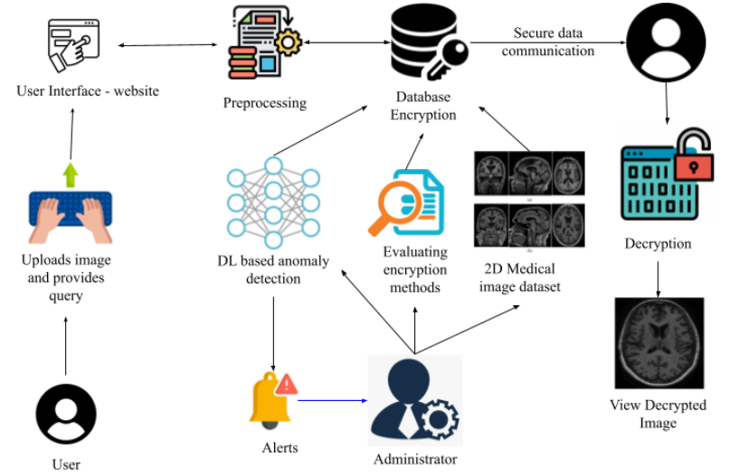
Architecture Diagram Of Hybrid End-to-end Encryption & Anomaly detection

Slide 15
MODULES
ADMIN MODULE
1.1 User Management
Manage user accounts, roles, and permissions.
1.2 Data Management
Oversee the management of medical image datasets, including uploading, organizing, and maintaining data integrity.
1.3 Encryption Settings
Configure encryption algorithms and settings for securing medical images.
2. USER MODULE
2.1 User Authentication
Implement secure login and access control mechanisms for users.
2.2 Image Upload and Encryption
Allow users to upload medical images for encryption using selected algorithms.
2.3 View Encrypted Images
Enable users to access and view encrypted medical images and their corresponding cryptographic hashes for integrity verification.

Slide 16
MODULES (Contd)
3. IMAGE ENCRYPTION MODULE
3.1 Algorithm Implementation
Implement various encryption algorithms for medical images:
RSA+AES+SHA-256
ECC+AES+SHA-256
AES+SHA-256
Chaotic Maps + AES
DNA Cryptography + AES
Blowfish+SHA-256
DES+AES+MD5
Rivest-Shamir-Adleman (RSA)
Elliptic Curve Cryptography (ECC)
Homomorphic encryption (if applicable)
3.2 Format Support
Support encryption for various medical image formats (DICOM, JPEG).
3.3 Performance Evaluation
Evaluate encryption performance metrics such as PSNR, SSIM, MSE, Edge preservation, Entropy and Encryption time.

Slide 17
IMAGE ENCRYPTION MODULE
ECC+AES+SHA-256:
Utilizes Elliptic Curve Cryptography (ECC) for secure shared key generation, ensuring efficient performance on resource-constrained devices with smaller key sizes and reduced computational load.
Protects image data with AES encryption, transforming it into an unreadable format to maintain confidentiality.
Verifies data integrity using a SHA-256-generated unique fingerprint, ensuring the image remains unaltered during transmission.
Combines these methods to deliver a secure and high-performance solution, ideal for real-time healthcare applications requiring quick access to protected data.
RSA+AES+SHA-256:
The first encryption method leverages a combination of asymmetric encryption (i.e., Rivest-Shamir-Adleman (RSA) algorithm) for key exchange and symmetric encryption (i.e., Advanced Encryption Standard (AES)) for fast data encryption.
The asymmetric encryption system is responsible for securely transferring the symmetric encryption key between the communicating parties.
Once the key is securely exchanged, the symmetric encryption algorithm is used to encrypt the medical image, ensuring both speed and security.
To ensure that the data has not been altered in transit, a cryptographic hash function (Secure Hash Algorithm 256-bit, also referred to as SHA-256) is used to generate a digest of the original image.
The encrypted image along with the hash is transmitted at the sender’s side and is received at the receiver’s side.
Then the image is decrypted, and a hash of decrypted image is generated and is compared with the received hash to verify that the image has remained intact during transmission.

Slide 18
IMAGE ENCRYPTION MODULE (Contd)
AES+SHA-256:
The AES + SHA-256 hybrid algorithm secures medical images by combining efficient encryption with integrity verification.
Data is encrypted using a symmetric encryption algorithm, ensuring high speed and strong security with a shared key used by both sender and receiver.
A cryptographic hash function generates a unique hash of the original image, serving as its digital fingerprint.
After decryption, the receiver recalculates the hash and compares it with the transmitted hash to verify data integrity.
This method balances speed, simplicity, and security, making it ideal for scenarios where asymmetric encryption isn't needed.
Chaotic Maps+AES:
The Chaotic Maps + AES hybrid encryption method adds unpredictability to AES encryption by utilizing chaotic systems for key generation.
Chaotic maps, highly sensitive to initial conditions, produce keys that are random and difficult to replicate, even with knowledge of the system's parameters.
The generated key is then used with AES to encrypt medical images, ensuring fast and strong data protection.
On the receiver's end, the same chaotic map parameters regenerate the key for decryption.
This combination enhances security against common cryptographic attacks, making it ideal for applications in healthcare, finance, and secure communications.

Slide 19
IMAGE ENCRYPTION MODULE(Contd)
Blowfish+AES:
This hybrid encryption method combines Blowfish, a lightweight symmetric encryption algorithm, with SHA-256 for securing medical images.
Blowfish ensures rapid encryption and decryption, making it ideal for resource-constrained environments with limited hardware.
To protect data integrity, SHA-256 generates a unique hash value, enabling the recipient to verify the image by comparing the recalculated hash with the original.
This approach balances speed and security but is susceptible to certain cryptographic attacks, such as brute-force or birthday attacks.
AES+DNA Cryptography:
The DNA Cryptography + AES method combines biological encoding with traditional encryption to enhance data security.
Medical image is encrypted using AES first then encoded into DNA sequence (Approach 1) which takes more time than approach 2 and doesn’t preserve the structures and patterns.
In approach 2, A medical image is first transformed into a DNA-like sequence, leveraging the complexity of DNA to obfuscate the data.
This encoded sequence is then encrypted using AES, adding a robust layer of protection. Decryption involves reversing the AES encryption and decoding the DNA sequence to restore the image.
This approach is highly secure, fast, preserves edges, structures and patterns in image making it ideal for applications requiring top-tier security.

Slide 20
IMAGE ENCRYPTION MODULE (Contd)
AES+DES+SHA-256:
In this encryption scheme, the medical image is first secured using DES, a traditional symmetric encryption method known for its speed but considered vulnerable by modern standards. To reinforce the security, a second layer of encryption is applied using AES, a more robust and widely trusted encryption algorithm. This two-step process helps enhance the overall security of the image, though it’s worth noting that DES alone is not recommended for high-security environments due to its susceptibility to various cryptographic attacks.
Additionally, the integrity of the encrypted image is ensured using MD5, a hash function that generates a fixed-length digest of the encrypted data. This hash acts as a signature for the image, allowing the recipient to verify whether the data has been altered during transmission. However, MD5 has known weaknesses, including its vulnerability to collision attacks, which can lead to hash collisions and compromise data integrity.
While this layered approach provides additional security through multiple encryption techniques, it is not ideal for high-risk applications due to the weaknesses inherent in both DES and MD5. It is better suited for scenarios where a balance of performance and moderate security is required.

Slide 21
TECHNOLOGY STACK
The required technology stack for implementation is
Hardware Specifications:
CPU: Intel Core i7/i9 (10th generation to 13th generation) or Intel Core Ultra 7/9 or AMD Ryzen 7 (5000 series or later)
RAM: 8/16 GB (DDR4/DDR5)
STORAGE: 512 GB SSD + 1 TB HDD
EXTERNAL CONNECTIONS: Keyboard, Mouse (wired or wireless)
MONITOR RESOLUTION: 1920 x 1080 (Full HD) or 4K (preferred)
GPU: NVIDIA GeForce GTX 1660 or AMD Radeon RX 6600 or higher
COOLING SYSTEM: Air or Liquid cooler
USB PORTS: 3.0
WIFI CONNECTION: Wi-Fi (802.11ac or later)
PRINTER: High-resolution printer (if required)
MINIMUM CPU CLOCK SPEED: 2.5 GHz or higher

Slide 22
TECHNOLOGY STACK (Contd)
Software specification:
OS: Windows 11 or Linux (Ubuntu 20.04 LTS or later)
LANGUAGE: Python 3.12 or higher
PLATFORM/IDE: Jupyter Notebook or Google Colab or Colab Pro or Anaconda or Visual Studio Code
PYTHON LIBRARIES: Numpy, matplotlib, pycryptodome, seaborn, skimage (scikit-image), pillow, cryptography, os, scipy, sklearn, hashlib, time, random
DATASET SOURCE: Kaggle, Cancer Imaging Archive
BROWSER: Google Chrome or any modern browser
ADDITIONAL TOOLS: Python package manager (pip/conda)

Slide 23
ANOMALY DETECTION MODULE
Autoencoders+CNNs:
-> An Autoencoder + CNN approach involves two key phases: unsupervised learning for anomaly detection and supervised classification for anomaly categorization.
-> The autoencoder is trained only on normal images to learn their underlying distribution and reconstruct normal images. During inference, if an input image deviates significantly from this learned pattern, the reconstruction error is high, indicating an anomaly.
-> When an unseen image is fed into the trained model, the autoencoder attempts to reconstruct it. If the reconstruction error exceeds a predefined threshold, the image is classified as anomalous. The detected anomalies are then passed to the CNN, which extracts features and categorizes them based on distortion types, such as noise, blurring, contrast shifts, or structural defects.
-> This combination of autoencoder-based anomaly detection and CNN-based classification enables precise identification of different types of image distortions.

Slide 24
ANOMALY DETECTION MODULE
2. GANs + CNNs: -> A GAN-based anomaly detection approach leverages the adversarial learning framework for both anomaly identification and classification. The GAN consists of a generator trained to produce realistic images and a discriminator that learns to distinguish between real and generated images. During training, the generator captures the distribution of normal images, ensuring that it can generate visually consistent samples. -> During inference, an unseen image is fed into the generator, which attempts to reconstruct it. If the reconstruction error or discriminator score significantly deviates from the expected pattern, the image is classified as anomalous. -> Detected anomalies are then processed by a CNN, which extracts features and categorizes them based on distortion types such as noise, blurring, contrast shifts, or structural defects. -> This integration of GAN-based anomaly detection with CNN-based classification enhances the model's ability to identify and categorize anomalies with high precision, leveraging both adversarial training and feature extraction.

Slide 25
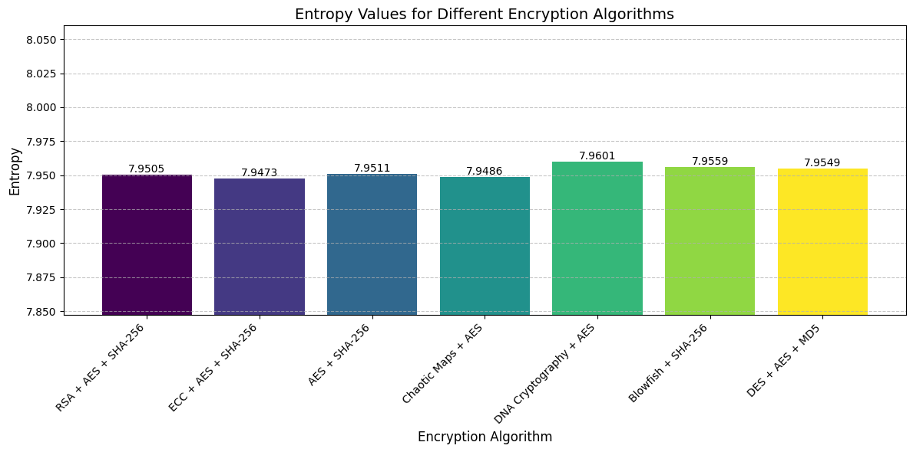
RESULTS (Achieved in Phase-1)
Similarity Index Measure (SSIM) score for the decrypted images for all the algorithms is 1.
Mean Squared Error (MSE) score for the decrypted images for all algorithms is 0.0.
Edge Preservation score for the decrypted images for all algorithms is 1.0.
Peak Signal-to-Noise Ratio (PSNR) score for the decrypted images for all algorithms is infinity.
Entropy score observed for decrypted images for all algorithms is shown in the graph below:

Slide 26
RESULTS (Contd)
Encryption time observed for each decrypted image for all algorithms is shown in the table below:
Hybrid Encryption Algorithms | Encryption time for each medical image
1. RSA + AES + SHA-256 | 0.05696s
2. ECC + AES + SHA-256 | 0.00012s
3. AES + SHA-256 | 0.00004s
4. Chaotic Maps + AES | 0.00003s
5. DNA Cryptography + AES | 0.00004s
6. Blowfish + SHA-256 | 0.00008s
7. DES + AES + MD5 | 0.00010s

Slide 27
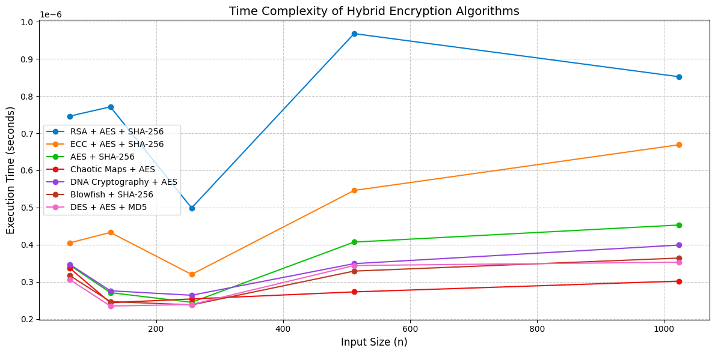
RESULTS (Achieved in Phase-2)
Execution time of hybrid encryption algorithms for varying input sizes is given below:

Slide 28
RESULTS (Achieved in Phase-2)
A comparison of encryption time and time complexity of all hybrid encryption algorithms is shown below:
Hybrid-Encryption algorithms | Encryption time for each medical image | Time complexity
1. RSA + AES + SHA-256 | 0.05696s | O(n³+m)
2. ECC + AES + SHA-256 | 0.00012s | O(n²+m)
3. AES + SHA-256 | 0.00004s | O(m)
4. Chaotic Maps + AES | 0.00003s | O(k + m)
5. DNA Cryptography + AES | 0.004303s - Method 1 0.00004s – Method 2 | O(d + m)
6. Blowfish + SHA-256 | 0.00008s | O(m)
7. DES + AES + MD5 | 0.00010s | O(m’ + m)

Slide 29
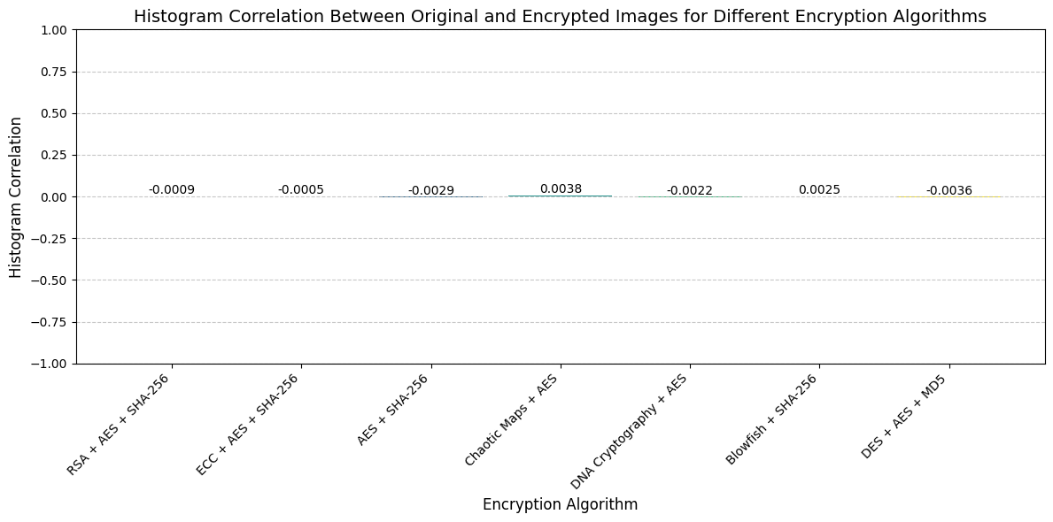
RESULTS (Achieved in Phase-2)
Histogram Correlation between the original and encrypted images for all hybrid encryption algorithms is shown below:

Slide 30
RESULTS (Achieved in Phase-2)
Anomaly Detection: Accuracy: 1) Autoencoder+CNN: 97.8 and 2) GANs+CNN: 96.1
Reconstruction Loss of normal images based on No of Epochs for Autoencoders + CNN and GANs + CNN hybrid deep learning algorithms is given below:
No of Epochs | Reconstruction Loss (Autoencoder + CNN) | Reconstruction Loss (GANs+CNN)
1 | 0.0271 | 0.1200
2 | 0.0149 | 0.3055
3 | 0.0107 | 0.3394
4 | 0.0083 | 1.3400
5 | 0.0068 | 0.1893
6 | 0.0062 | 0.0799
7 | 0.0056 | 0.2523
8 | 0.0053 | 0.1781
9 | 0.0050 | 0.2960
10 | 0.0046 | 0.3124

Slide 31
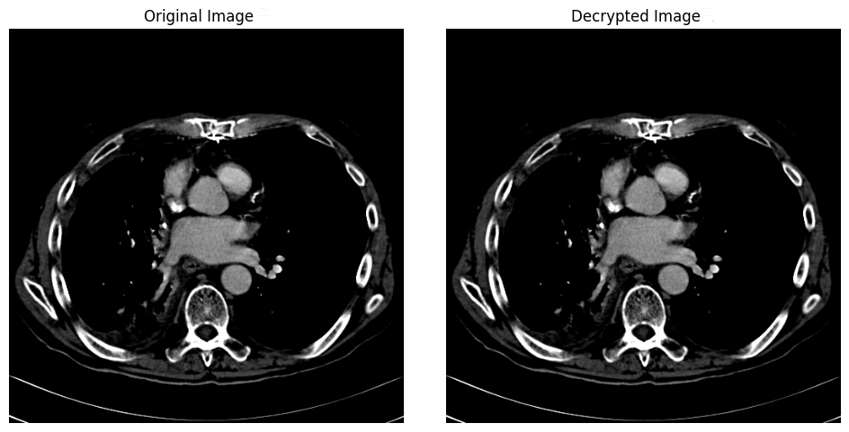
OUTPUT (Achieved in Phase-1)
Original Image vs Decrypted Image

Slide 32
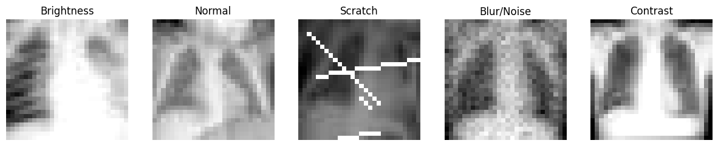
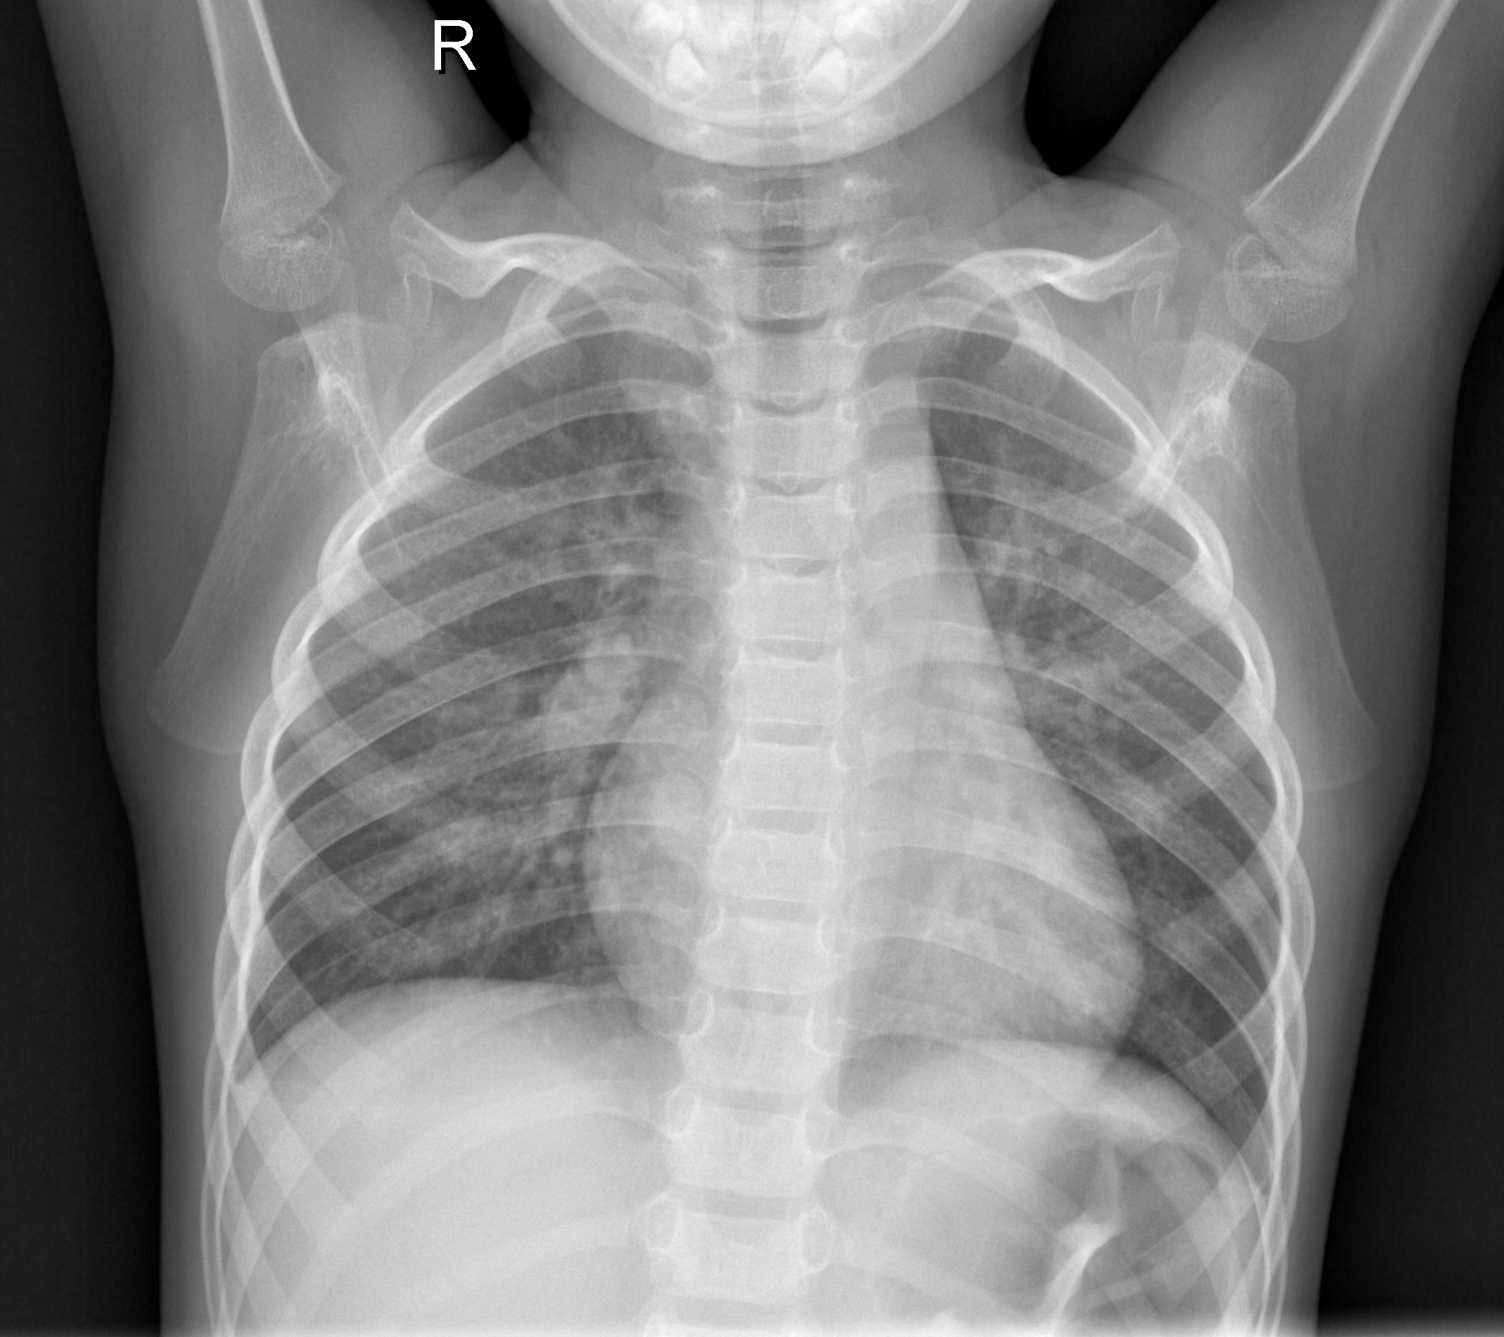
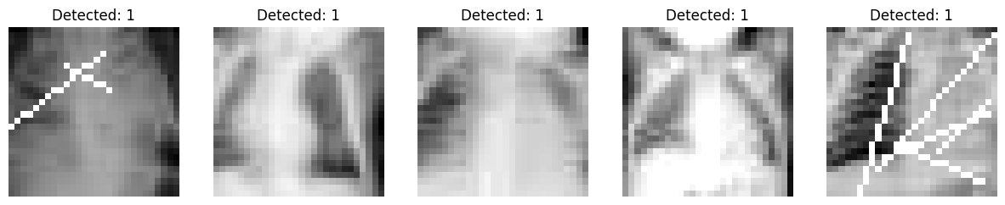
OUTPUT (Achieved in Phase-2)
Images of each labelled category are displayed below:
Normal
5 Predicted anomaly images of total predicted anomaly images of test set is displayed below:

Slide 33
CONCLUSION AND FUTURE WORK
High entropy scores indicate robust resistance to unauthorized access.
DNA Cryptography + AES (Approach 2) offers maximum security , takes less time , preserves patterns and edges but poses implementation challenges due to complexity.
Chaotic Maps + AES and Blowfish + SHA-256 provide faster encryption suitable for speed-critical applications.
ECC + AES + SHA-256 is ideal for mobile devices, balancing security and efficiency.
Future focus: Encrypting 3D medical images to address challenges of higher dimensionality and complexity.
Develop lightweight hybrid encryption algorithms optimizing security and performance for healthcare needs.
Boost anomaly detection to cover diverse distortions imaging modalities with better accuracy.
These advancements will be crucial in catering to the growing demands of modern healthcare applications, enabling secure data transmission while meeting the operational efficiency required in an interconnected digital healthcare landscape.

Slide 34

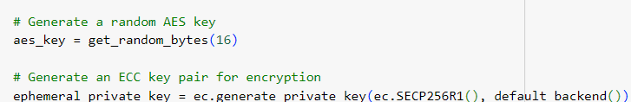
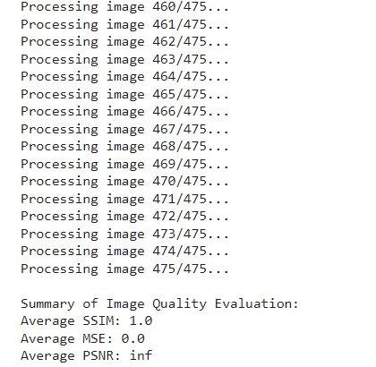

SCREENSHOTS

Slide 35
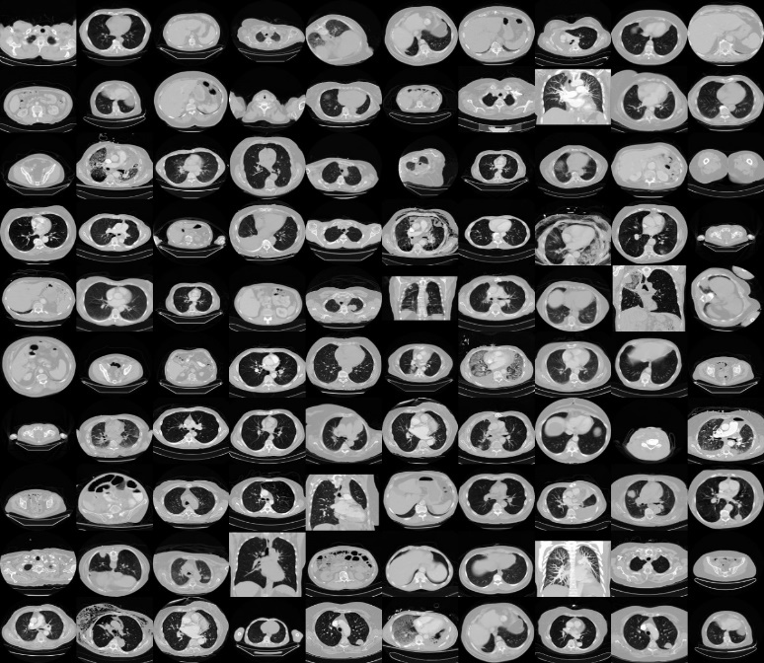
SCREENSHOTS (Contd)

Slide 36
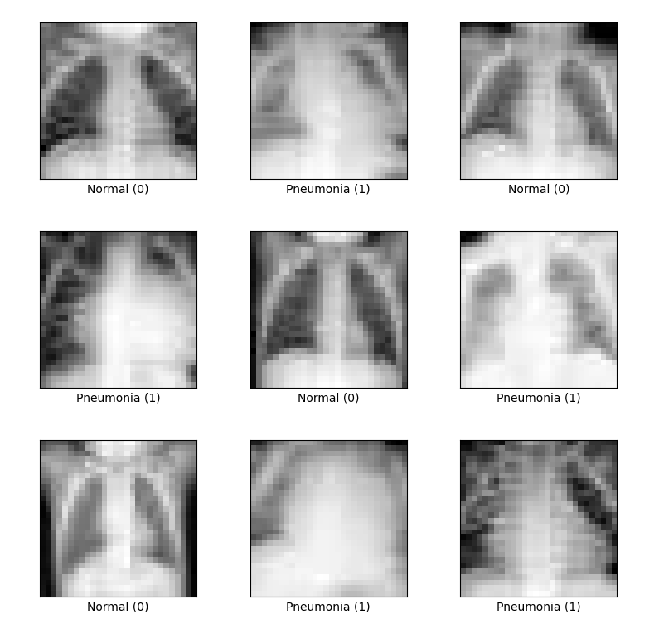
SCREENSHOTS (Contd)

Slide 37
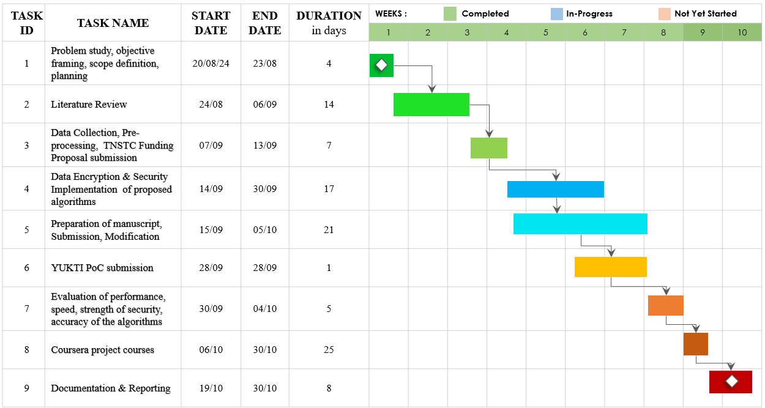
PROJECT TIMELINE USING GANTT CHART (Phase 1)

Slide 38
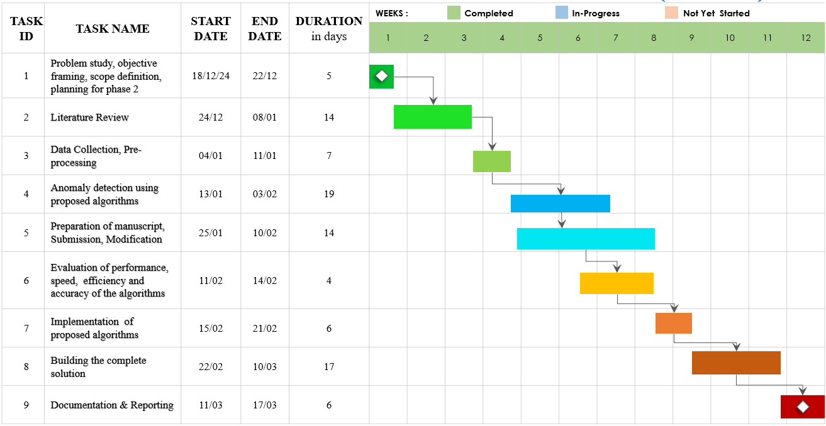
PROJECT TIMELINE USING GANTT CHART (Phase 2)

Slide 39
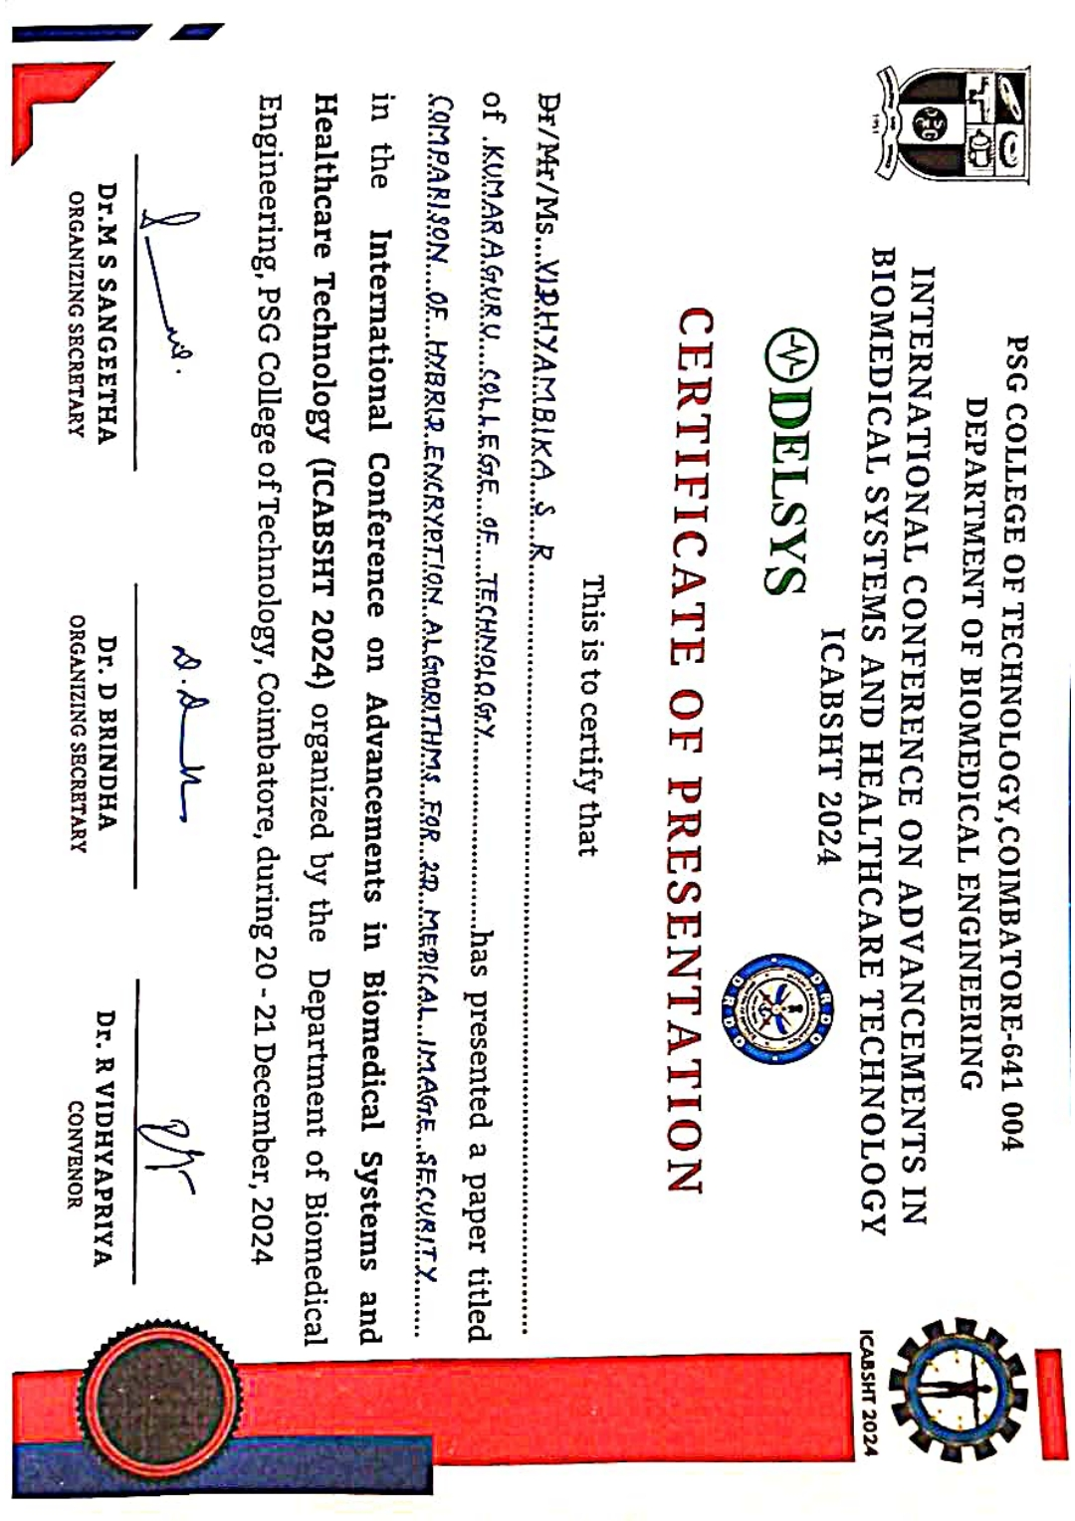
ACHIEVEMENTS
Project proposal was submitted for funding to Tamil Nadu State Council for Science and Technology (TNSTC) on 9th September.
Proof of Concept (PoC) was submitted to YUKTI National Innovation Repository on 28th September.
Manuscript titled “Comparison of Hybrid Encryption Algorithms for Medical Image Security” was submitted to International Conference on Advancements in Biomedical Systems and Healthcare Technology at PSG College of Technology, Coimbatore on 5th October. The manuscript was accepted and the paper was presented on 20-12-2024 and got published in Conference proceedings with ISBN.

Slide 40
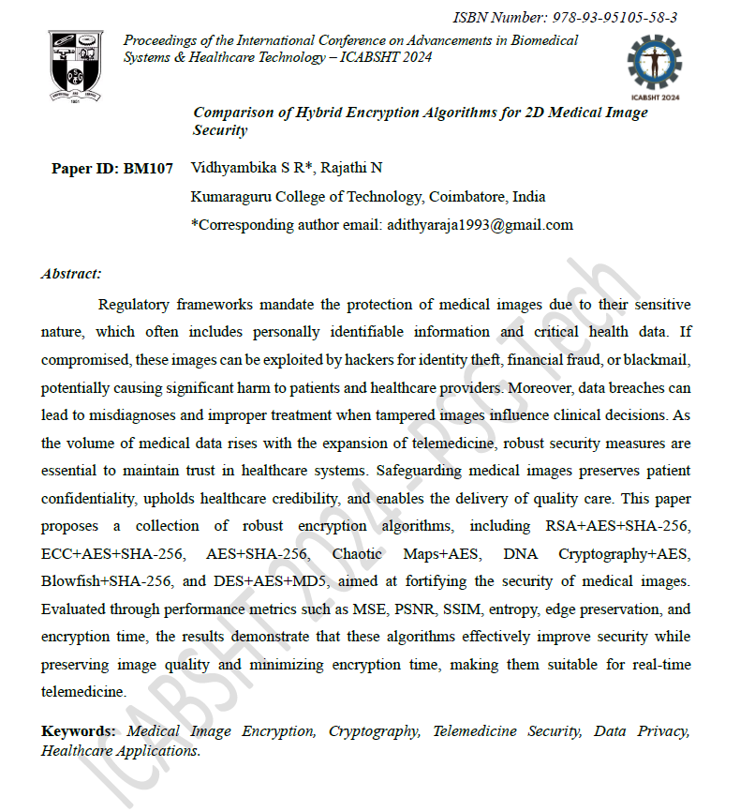
ACHIEVEMENTS (Contd)
The manuscript titled “Hybrid Encryption Algorithms for 2D Medical Image Security and Anomaly Detection: A Novel Approach” was submitted and accepted at the IEEE Technical Co-sponsored International Conference on Computational Innovations and Engineering Sustainability. I have also successfully submitted the camera-ready version.

Slide 41

ACHIEVEMENTS (Contd)

Slide 42
BENEFITS
Protecting patient privacy
Data Integrity
Secure Data Sharing
Maintaining Reputation
Mitigation of Legal Risks
Support for Radiologists
Support for Remote Diagnostics
Improved Accuracy
Reduced Diagnostic Errors
Reduced Healthcare Costs
Prevention of Identity Theft
🔒

Slide 43
REFERENCES
A. Alzahrani and N. A. Memon, “Blind and robust watermarking scheme in hybrid domain for copyright protection of medical images,” IEEE Access, vol. 9, pp. 113714–113734, Jan. 2021, doi: 10.1109/access.2021.3104985.
S. Rajendran and M. Doraipandian, “Chaos based secure medical image transmission model for IoT- powered healthcare systems,” IOP Conference Series Materials Science and Engineering, vol. 1022, no. 1, p. 012106, Jan. 2021, doi: 10.1088/1757-899x/1022/1/012106.
Y. Ding, F. Tan, Z. Qin, M. Cao, K.-K. R. Choo, and Z. Qin, “DeepKeyGen: a deep Learning-Based stream cipher generator for medical image encryption and decryption,” IEEE Transactions on Neural Networks and Learning Systems, vol. 33, no. 9, pp. 4915–4929, Sep. 2022, doi: 10.1109/tnnls.2021.3062754.
F. Yang, J. Mou, K. Sun, and R. Chu, “Lossless image compression-encryption algorithm based on BP neural network and chaotic system,” Multimedia Tools and Applications, vol. 79, no. 27–28, pp. 19963–19992, Apr. 2020, doi: 10.1007/s11042-020-08821-w.
“A novel Plaintext-Related image encryption scheme based on chaotic system and pixel permutation,” IEEE Journals & Magazine | IEEE Xplore, 2020. https://ieeexplore.ieee.org/document/8972445
A. A. Khalil et al., “Efficient anomaly detection from medical signals and images with convolutional neural networks for Internet of medical things (IoMT) systems,” International Journal for Numerical Methods in Biomedical Engineering, vol. 38, no. 1, Dec. 2021, doi: 10.1002/cnm.3530.
“Generative Adversarial networks for Anomaly Detection in Biomedical Imaging: A study on seven medical image datasets,” IEEE Journals & Magazine | IEEE Xplore, 2023. https://ieeexplore.ieee.org/document/10043696/authors#authors

Slide 44
REFERENCES (Contd)
8. “Hyperspectral anomaly detection with OTSU-Based Isolation Forest,” IEEE Journals & Magazine | IEEE Xplore, 2021. https://ieeexplore.ieee.org/document/9531356
9. “ANOVIT: Unsupervised Anomaly Detection and Localization with Vision Transformer-Based Encoder-Decoder,” IEEE Journals & Magazine | IEEE Xplore, 2022. https://ieeexplore.ieee.org/document/9765986
10. “Anomaly detection in medical imaging with deep perceptual autoencoders,” IEEE Journals & Magazine | IEEE Xplore, 2021. https://ieeexplore.ieee.org/document/9521238

Slide 45
CLARIFICATIONS, IF ANY

Slide 46
THANK YOU

